Slide 1
3D Face Recognition Project Report
Mouqing Jin
03/20/2018

Slide 2
Outline
Data collection with RealSense
Face Detection model
Comparison between Deep Learning & Machine Learning
ARS(angular radial signature) method

Slide 3
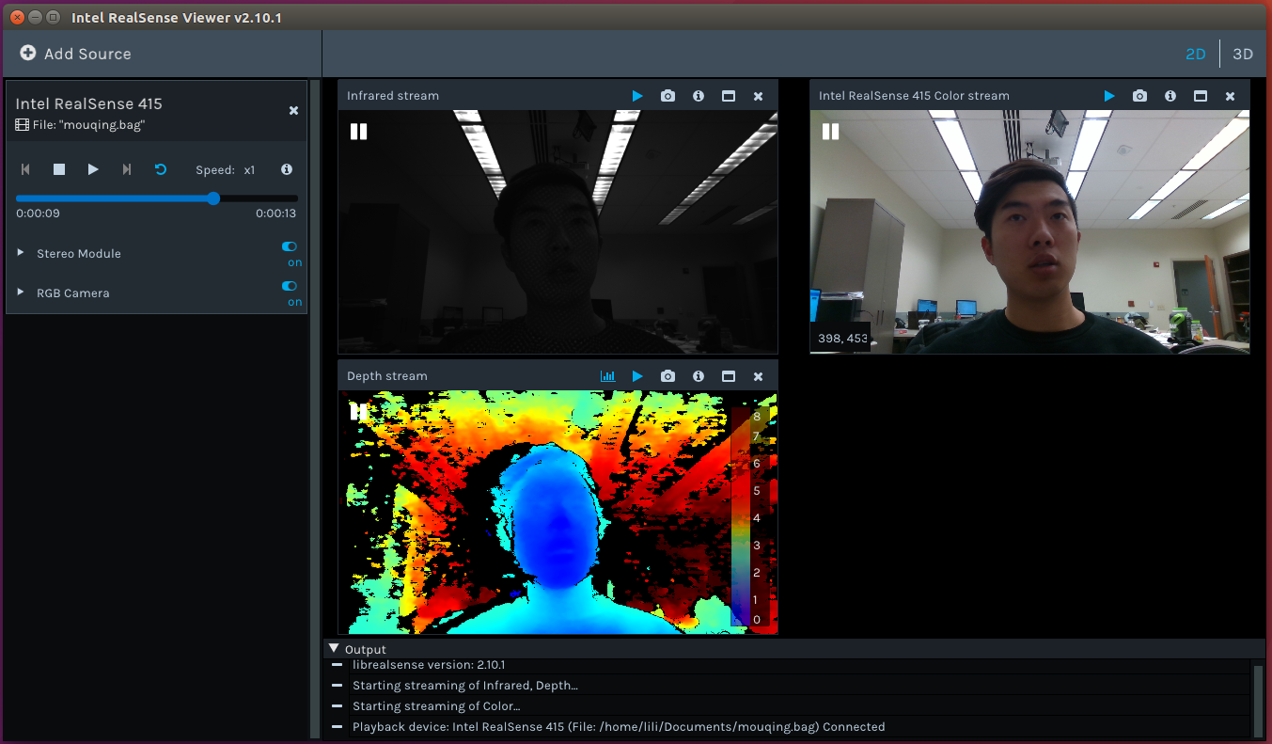
Data Collection
11 person
10 second video
RGB image, Depth image, and .ply file.

Slide 4
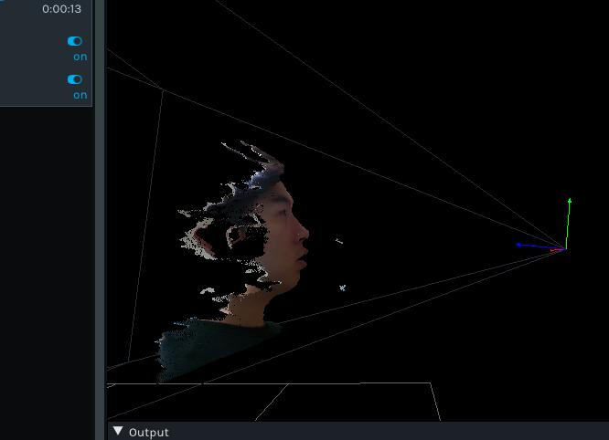
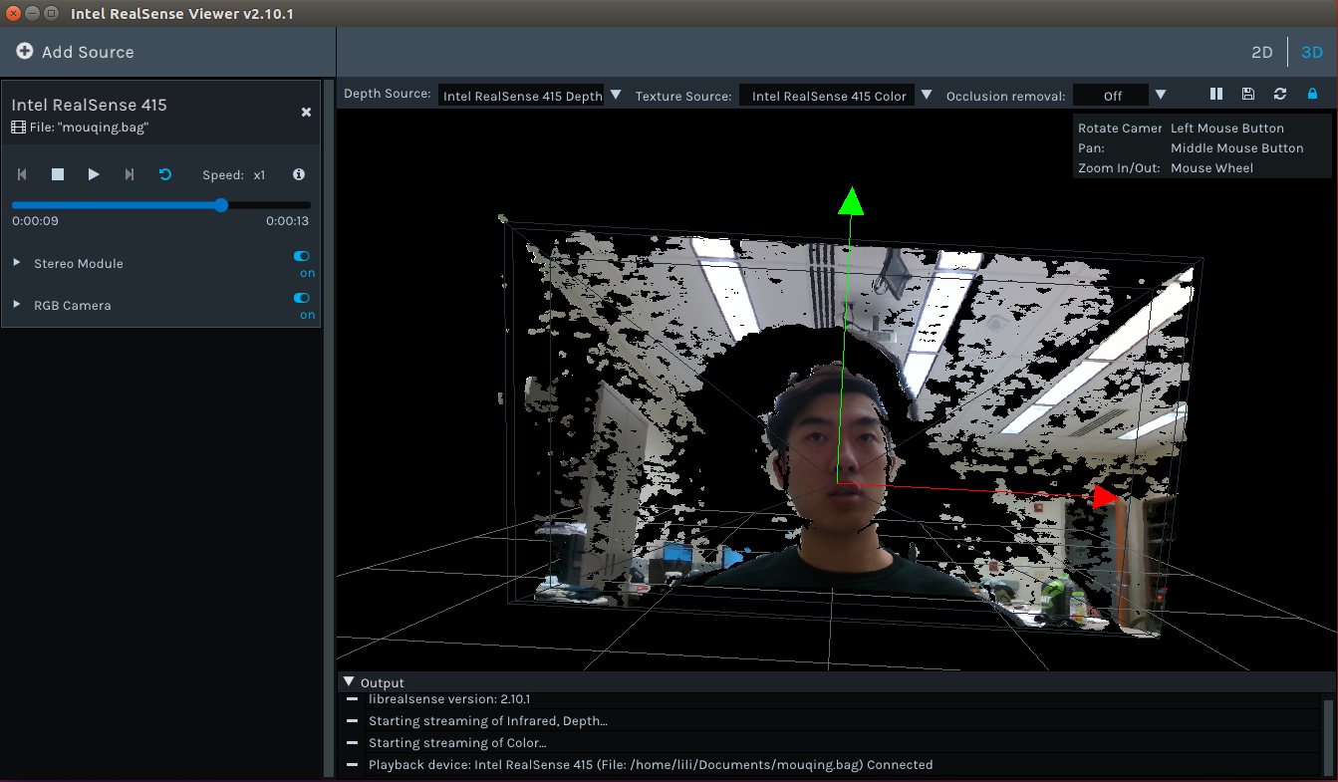
Data Collection
Point Cloud .ply file

Slide 5
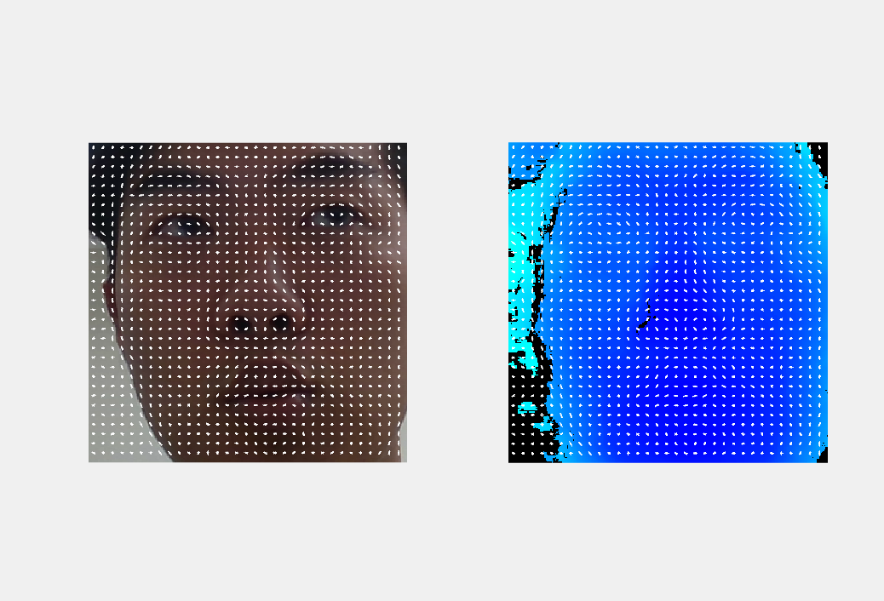

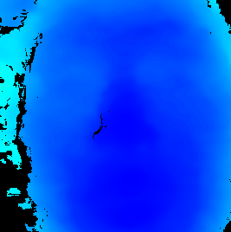
Face Detection model
Face Detection model in RGB and Depth
The hog features

Slide 6
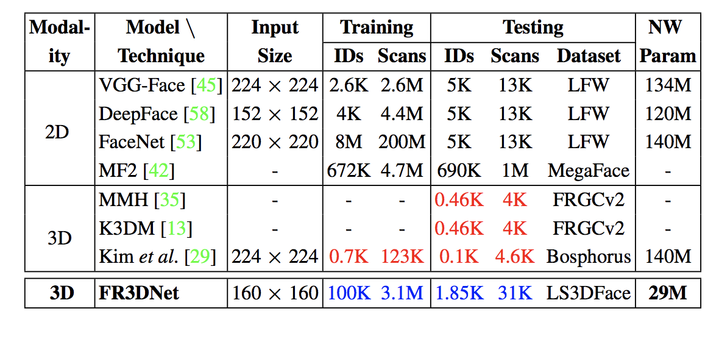
Deep learning method comparing
State-of-the-art 2D face recognition.
3D face recognition algorithms are tested on just a few
The proposed FR3DNet is trained on 3.1M 3D scans and tested on 1.85K identities.

Slide 7
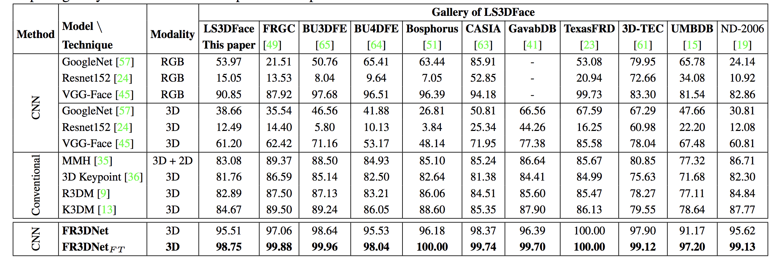
Deep learning method comparing
Comparison of face recognition accuracy (%) on LS3DFace with state-of-the-art deep and conventional methods .
They have used the complete gallery of LS3DFace in all experiments reported here.

Slide 8
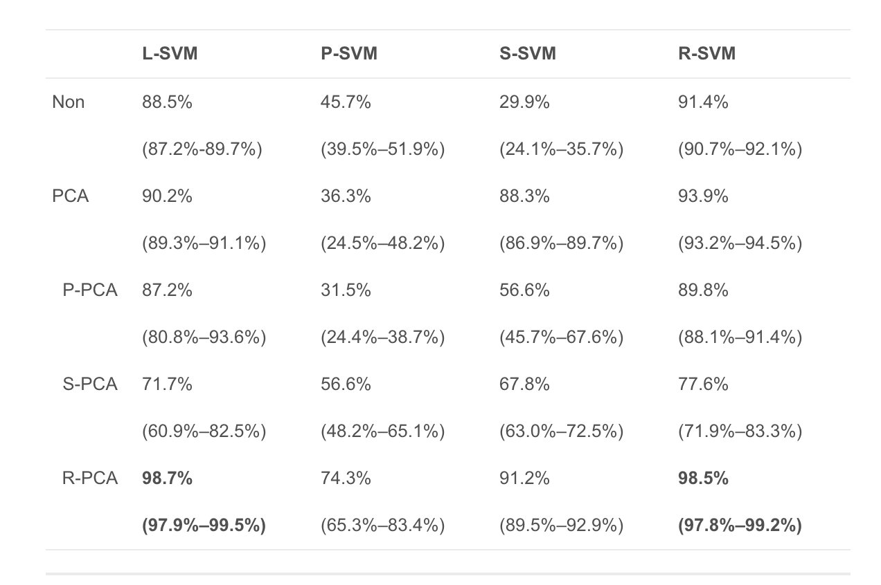
Machine learning method
Tested on the FRGC v2.0 and the SHREC 2008 datasets
KPCA and SVM with different kernels: linear (L), polynomial (P), sigmoid (S) and RBF (R)

Slide 9
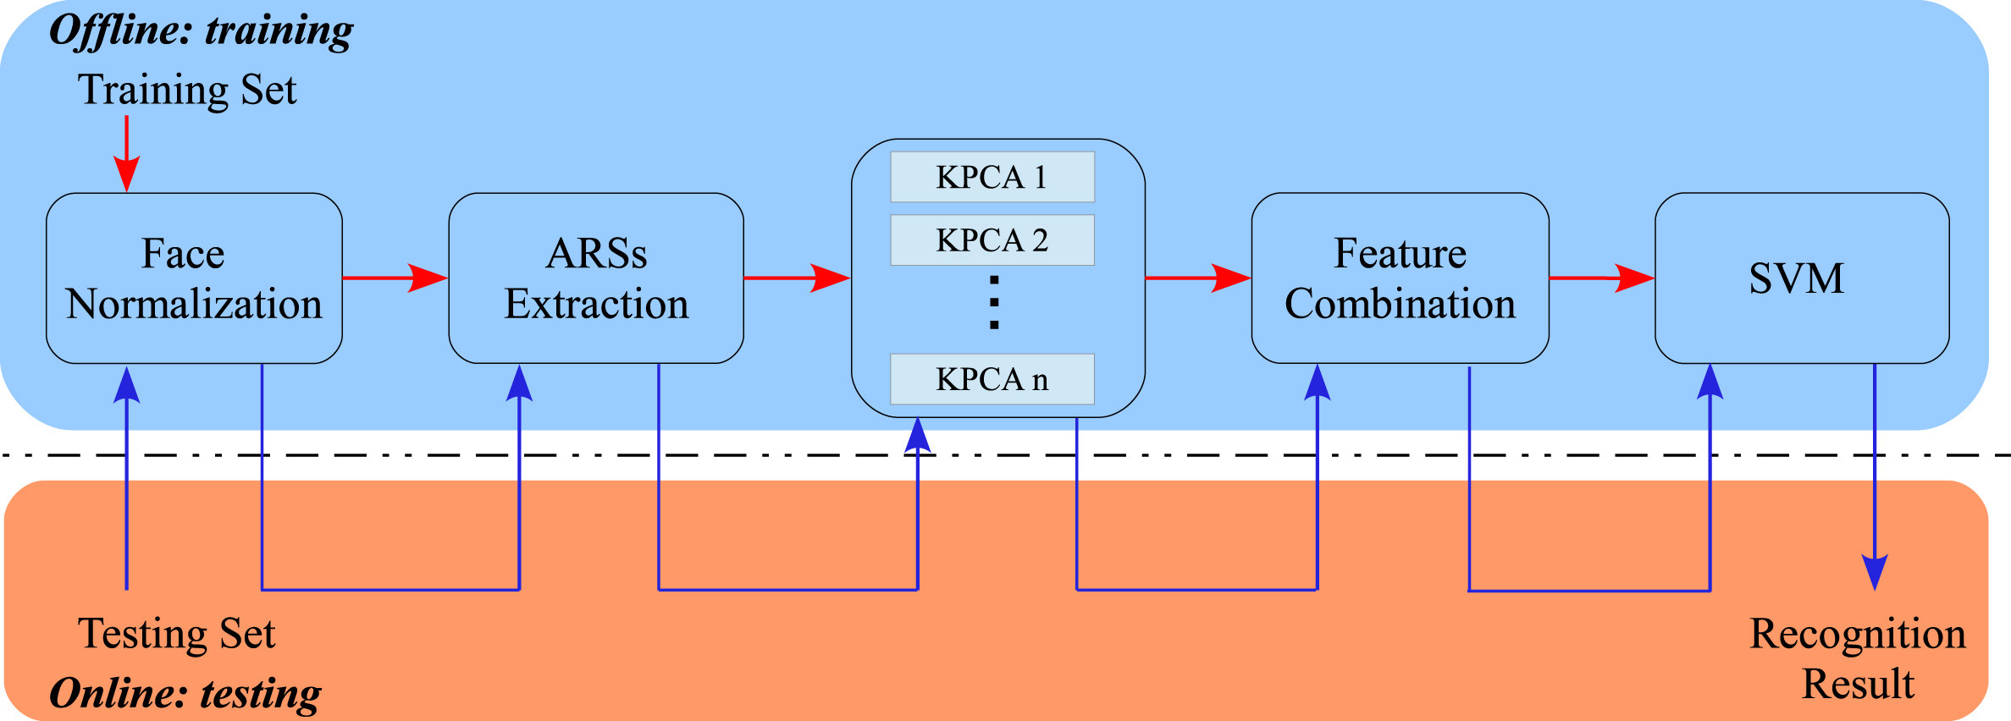
Angular Radial Signature Method
A 3D face normalization algorithm (nosetip detection, face cropping)
Decompose a 3D face into a set of 1D feature vectors
nonlinearly map the ARS features into a high-dimensional mid-level feature space
The learned SVM model is then used to classify input face

Slide 10
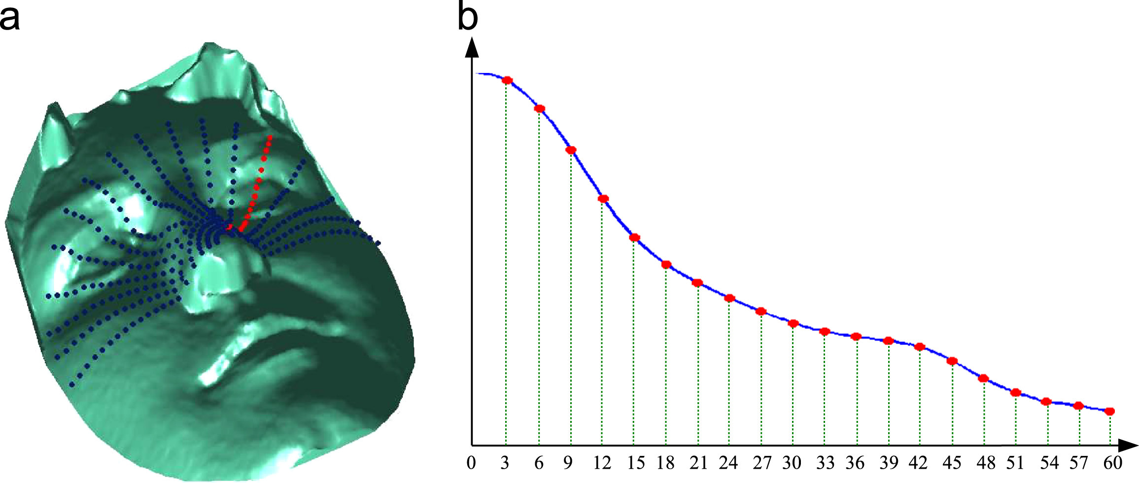
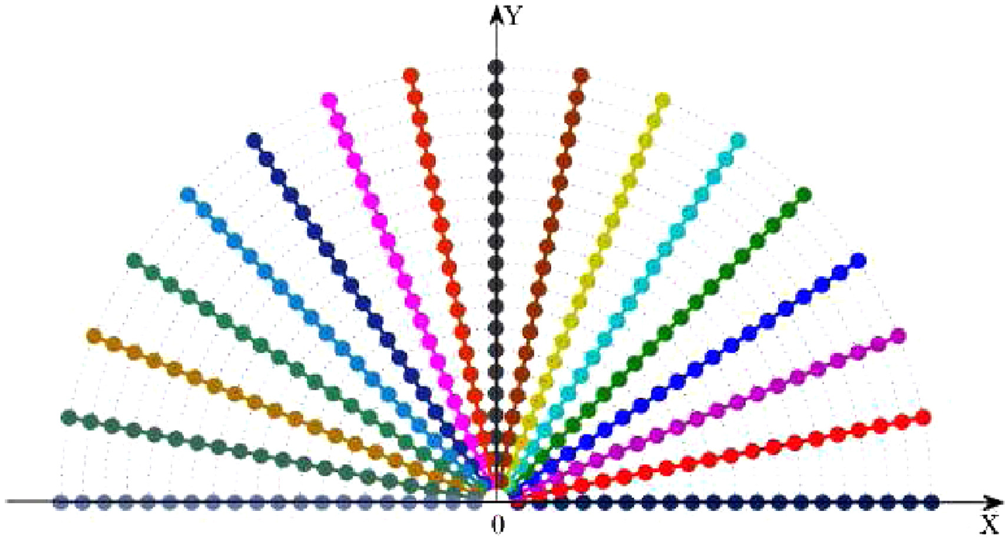
Angular Radial Signature
The ARSs are defined as a set of curves, emanating from the nosetip.
N paths, 20 points, 3 mm, 60 mm.
the depth value (ARS feature value) of these points
a 3D face is represented by NARSs, which actually correspond to a set of N 1D feature vectors.

Slide 11
Reference
[1711.05942] Learning from Millions of 3D Scans for Large-scale 3D ...
A training-free nose tip detection method from face range images ...
An efficient 3D face recognition approach using local geometrical ...

Slide 12
Thank you!

